Slide 1
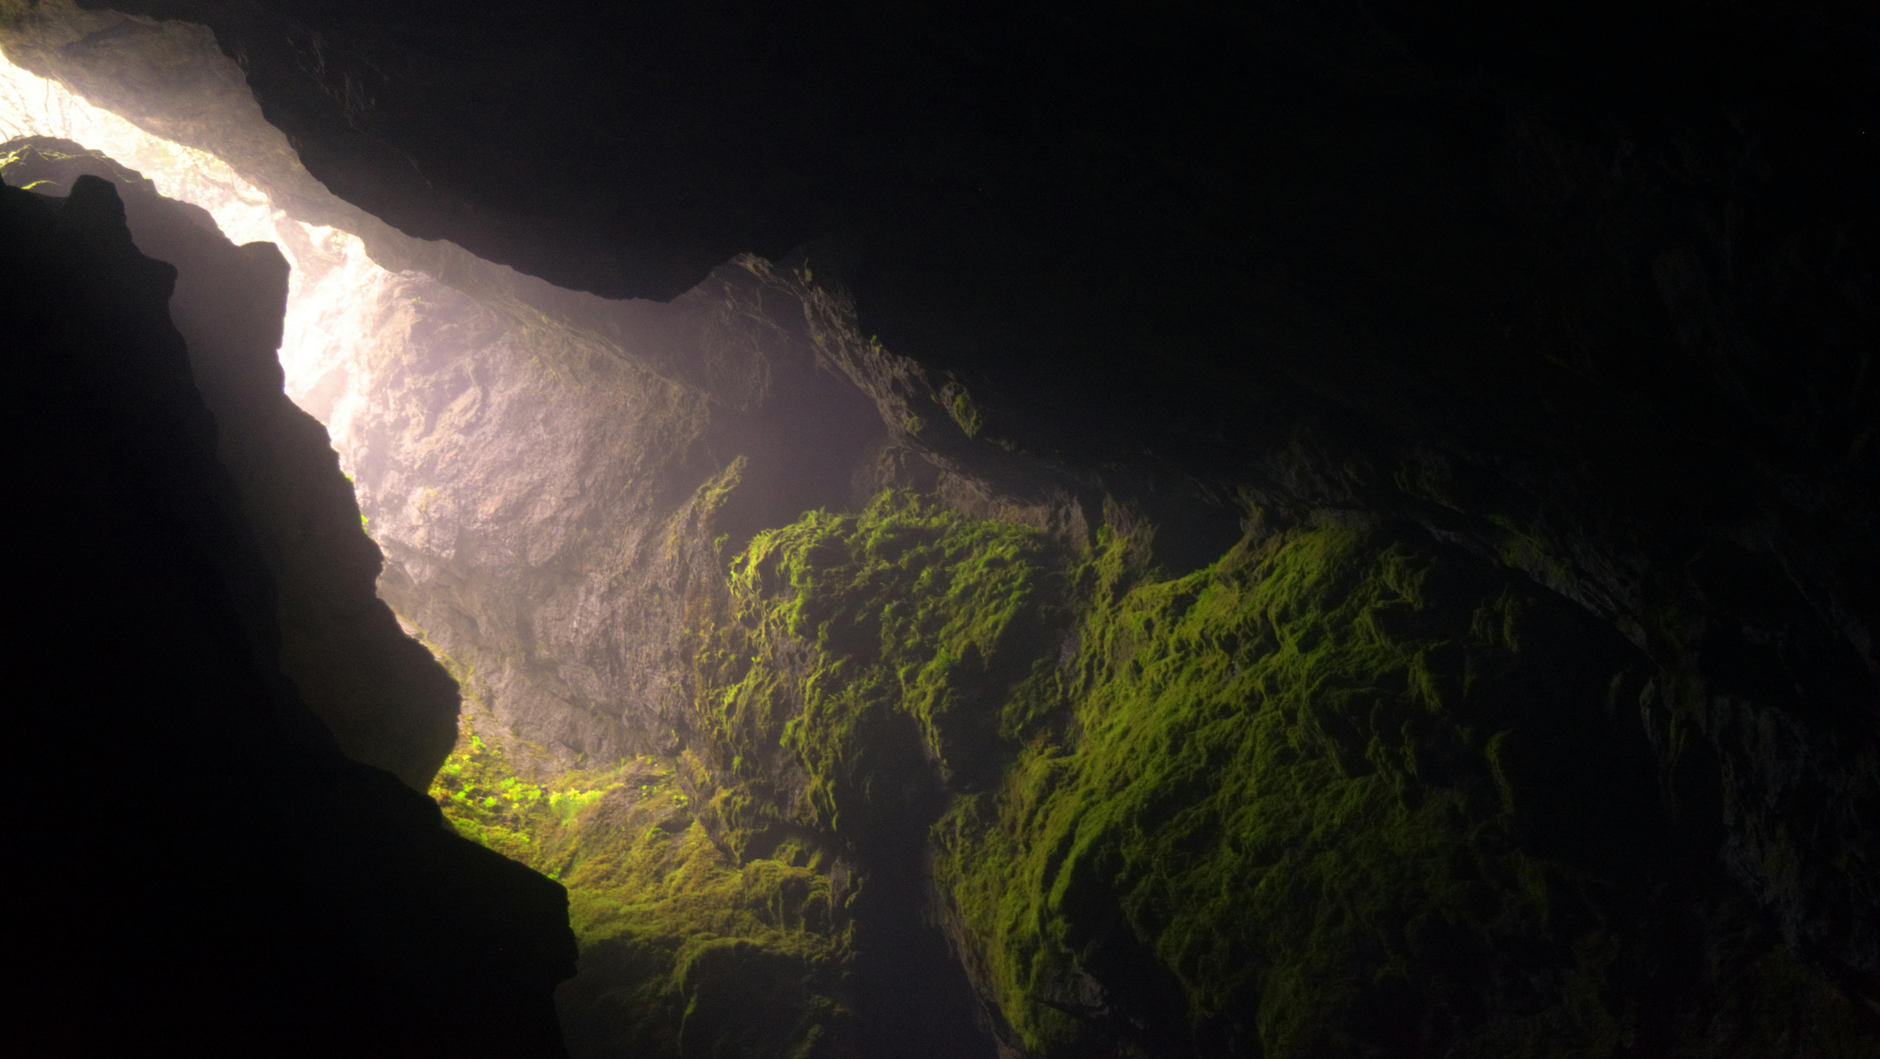
A Campaign made of Classes…
What exactly is this project?

Slide 2

An RPG campaign
Made for the classic game Dungeons and Dragons.
A software that allows user to keep track of everything in your campaign, such as weapons and battles.
In battles, user can use Rolls for certain actions and choose how to interact with the battles you are in

Slide 3

Developed by us…
Amberlee Aponte: Tech Lead
Bailey Perillo: Manager
Illir Krasniqi: Developer

Slide 4

These roles demanded that we do the following…
Tech Lead
Guide fellow group members on what should be done
Create resolutions to certain problems and communicate them to fellow members
Assist to whatever coding problems that occurs
Project Manager
Keep us on track and initiate what our next move for the project is
Documenting all progress in our project development
Developer
Plans on how the software is implemented
Assists group members in how the software is being implemented
Keep track of what each lines of code execute

Slide 5
Nothing is perfect…
We have had certain problems when it came to developing the software such as:
Unexpecting scheduling issues, it was difficult for us to be in the same call most of time, so we made it a priority to write post anything new that came up in our meetings.
Making changes for how our software would be implemented halfway through the coding process, to combat this we would start off small with what we wanted and then build from there
Miscommunication, we needed to get to the point of what we wanted instead of beating around the bush, stop rambling.
Know our limits, if things are too much voice your concerns, also listen to your fellow group members when they voice theirs.

Slide 6
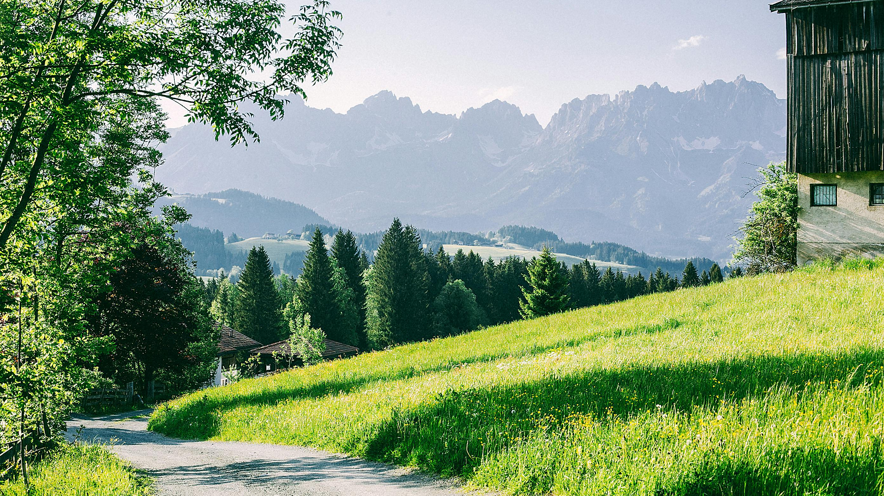
Bare necessities...
Our minimum viable product must have a basic set of features for it to be presentable
Since this is a tool for DnD campaigns, it means it needs to build and keep track of the stats of our characters.
There needs to be a battle feature complete with dice rolling and fighting enemies
The user has a turn and then the enemy, so on and so forth…

Slide 7
UML

Slide 8

Technology
We developed our project using Replit mostly for easy access and the autosave feature
Also allows us to easily run to make several tests and find bugs

Slide 9

Future plans…
If we were to continue modifying this project…
We would add a field mode
Build classes to interact with NPC’s
Set up an environment to interact with
Have a dialogue system

